Slide 1
Arthur Miller

Slide 2
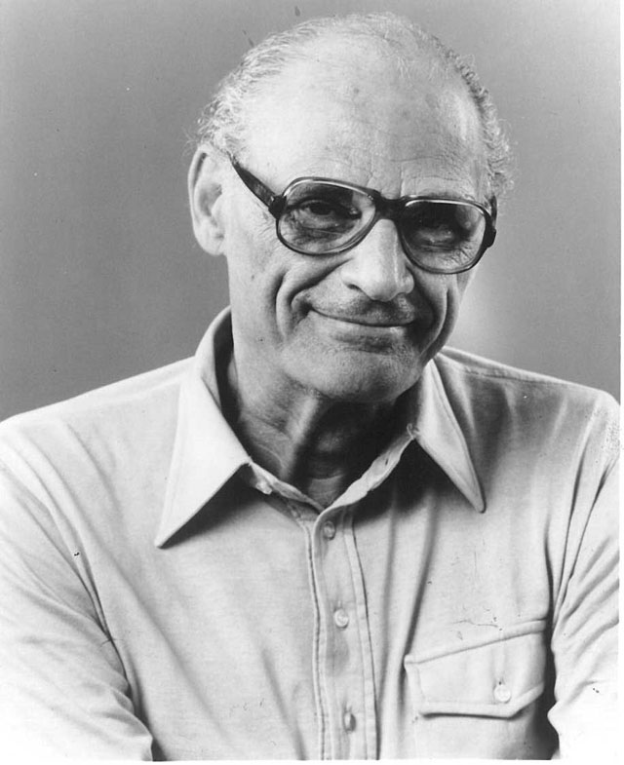
Arthur Asher Miller (October 17, 1915 – February 10, 2005) was a prolific American playwright, essayist, and prominent figure in twentieth-century American theatre. Among his most popular plays are All My Sons (1947), Death of a Salesman (1949), The Crucible (1953) and A View from the Bridge (1955, revised 1956). He also wrote several screenplays and was most noted for his work on The Misfits (1961). The drama Death of a Salesman is often numbered on the short list of finest American plays in the 20th century alongside Long Day's Journey into Night and A Streetcar Named Desire.

Slide 3
Miller was often in the public eye, particularly during the late 1940s, 1950s and early 1960s. During this time, he was awarded the Pulitzer Prize for Drama; testified before the House Un-American Activities Committee; and was married to Marilyn Monroe. He received the Prince of Asturias Award and the Premium Imperial prize in 2002 and the Jerusalem Prize in 2003，as well as the Dorothy and Lillian Gish Lifetime Achievement Award and the Pulitzer Prize.

Slide 4
Biography
Arthur Asher Miller was born on October 18, 1915, in Harlem, in the New York City borough of Manhattan, the second of three children of Augusta (Barnett) and Isidore Miller. Miller was Jewish
His family background was not bad. But in the wall Street Crash of 1929, the family lost almost everything and moved to Gravesend, Brooklyn. As a teenager, Miller delivered bread every morning before school to help the family. After graduating in 1932 from Abraham Lincoln High School, he worked at several menial jobs to pay for his college tuition.

Slide 5
At the University of Michigan, Miller first majored in journalism and worked for the student paper, the Michigan Daily. It was during this time that he wrote his first play, No Villain. Miller switched his major to English, and subsequently won the Avery Hopwood Award for No Villain. The award brought him his first recognition and led him to begin to consider that he could have a career as a playwright. Miller enrolled in a playwriting seminar taught by the influential Professor Kenneth Rowe, who instructed him in his early forays into playwriting
Miller retained strong ties to his alma mater throughout the rest of his life, establishing the university's Arthur Miller Award in 1985 and Arthur Miller Award for Dramatic Writing in 1999, and lending his name to the Arthur Miller Theatre in 2000.

Slide 6
Famous Work
All My Sons
Death of A Salesman
A View from the Bridge
The Crucible

Slide 7
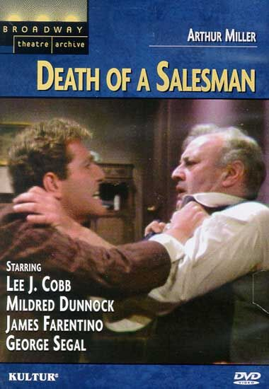
Death of a Salesman
Death of a Salesman is a 1949 play written by American playwright Arthur Miller. It was the recipient of the 1949 Pulitzer Prize for Drama and Tony Award for Best Play. The play premiered on Broadway in February 1949, running for 742 performances, and has been revived on Broadway four times, winning three Tony Awards for Best Revival. It is widely considered to be one of the greatest plays of the 20th century.

Slide 8
A Brief Introduction of This Novel
Willy Loman, a salesman of a clothing company in New York. His work was to sale clothes to others. And he always believed that he would be rich one day though his work. Unfortunately, he was fired as he was too old after 36 years. This accident really hurt him, he was extremely disappointed.
When he came back home, he told his wife about this but his wife just accepted it calmly and smiled to him. This reaction really made Willy feel more stressful.
As for his two sons, Biff and Happy, they were both lazy and had no legal job. They did not reach their father’s expectation. Their bad life ruined Willy’s final hope. So their father chose to die to end all things.

Slide 9
The Moral
This book was written in 1949. At that time, America’s economy was prosperous; but there was always a big gap between the rich and the poor.
“The American Dream” was fairly popular at that time but it made no sense. As for Willy, his death was just a typical phenomenon at that time.
It showed a rule that the losers had no right to alive in America at that time; it was the rich’s era. And it also showed that some people just held a reachless dream and never did useful things to achieve their goals.

Slide 10
Marriage
(His First Wife)
In 1940, he married Mary Grace Slattery. The couple had two children, Jane and Robert (born May 31, 1947). Miller was exempted from military service during World War II because of a high-school football injury to his left kneecap. 1940 was also the year his first play was produced; The Man Who Had All the Luck won the Theatre Guild's National Award.

Slide 11
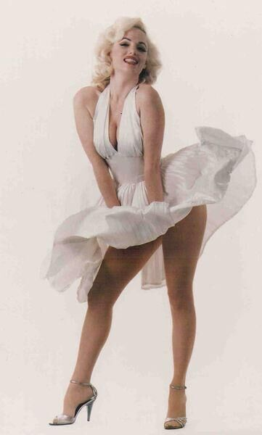

Slide 12
His Second Wife——Marilyn Monroe
Miller's second wife, Marilyn Monroe, in her final completed film, The Misfits (1961). In June 1956, Miller left his first wife Mary Slattery and on June 29 he married Marilyn Monroe. Miller and Monroe had met in April 23, 1951, when they had a brief affair, and had remained in contact since then. Miller began to work on The Misfits, starring his wife. Miller later said that the filming was one of the lowest points in his life; shortly before the film's premiere in 1961, the pair divorced.19 months later, Monroe died of a possible drug overdose.

Slide 13
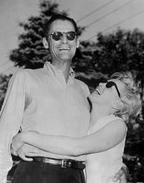
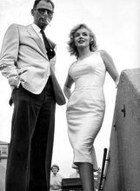
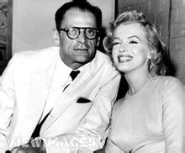
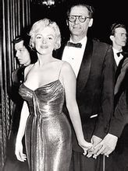
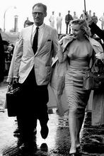
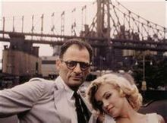

Slide 14
His Third Wife
Miller's future wife Inge Morath worked as a photographer documenting the film's production. The film proved to be the last appearances for both Monroe and Clark Gable, and one of the last for Montgomery Clift. Miller married photographer Inge Morath on February 17, 1962 and the first of their two children, Rebecca, was born September 15, 1962. Their son Daniel was born with Down syndrome in November 1966; he was institutionalized and excluded from the Millers' personal life at Arthur's insistence. The couple remained together until Inge's death in 2002. Arthur Miller's son-in-law, actor Daniel Day-Lewis, is said to have visited Daniel frequently, and to have persuaded Arthur Miller to reunite with his adult son, Daniel.

Slide 15
His Death
Miller died of heart failure after suffering from cancer, pneumonia and congestive heart disease, at his home in Roxbury, Connecticut. He had been in hospice care at his sister's apartment in New York since his release from hospital the previous month. He died on the evening of February 10, 2005 (the 56th anniversary of the Broadway debut of Death of a Salesman), aged 89, surrounded by Barley, family and friends. He is interred at Roxbury Center Cemetery in Roxbury.

Slide 16
Thank You

